Slide 2
The epidemiology and vulnerability of missing and Indigenous populations
Stefan Baral
Center for Public Health and Human Rights
Department of Epidemiology
Johns Hopkins School of Public Health

Slide 3
Outline
Acknowledgments
HIV Pandemic in 2018
Case Studies of Differential HIV Risks and Burden
  Adolescent Girls and Young Women in Tanzania
  People Who Inject Drugs in the Russian Federation
  Gay Men and other Men who have Sex with Men & Transgender Women in Senegal
  Indigenous Communities in Latin America
  Female Sex Workers in Southern Africa
Moving Forward

Slide 4

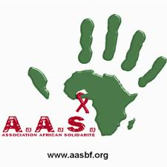
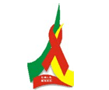
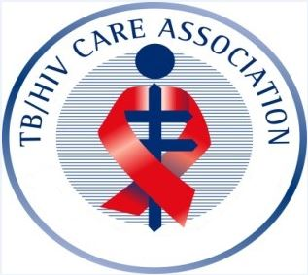

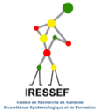

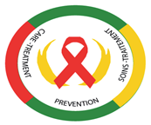





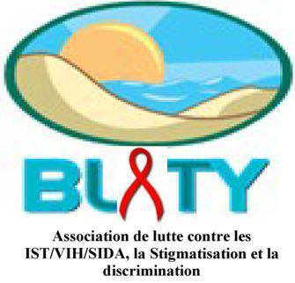
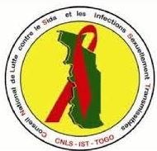

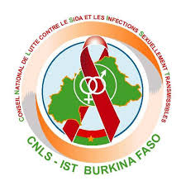



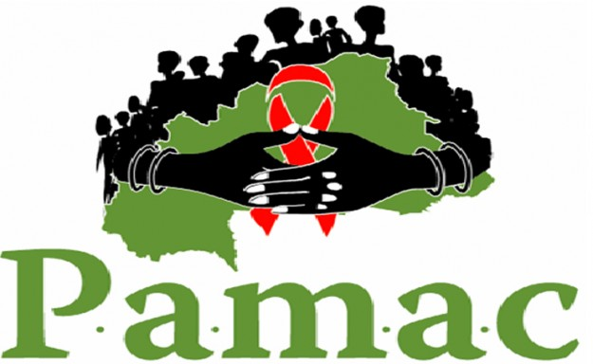









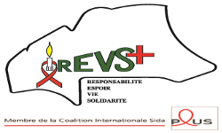

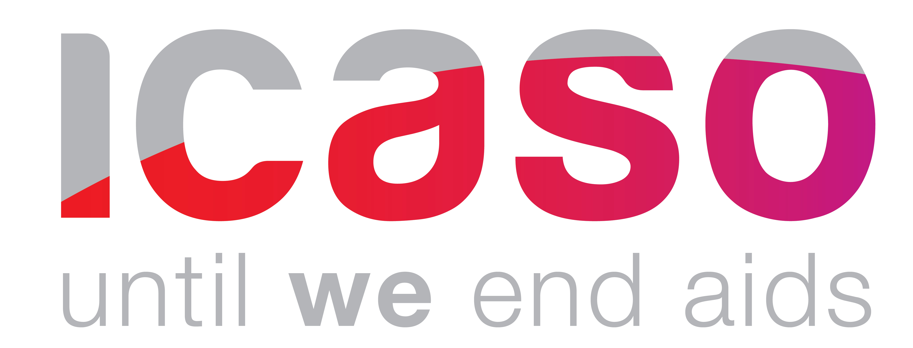

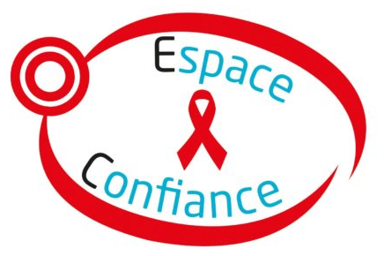






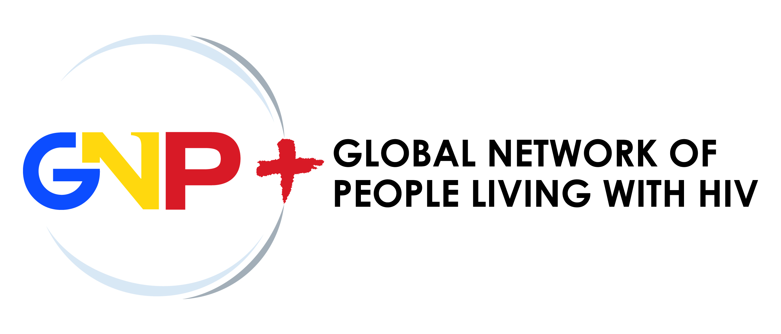










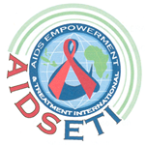




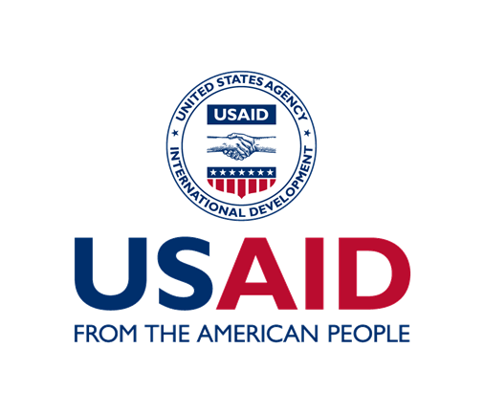





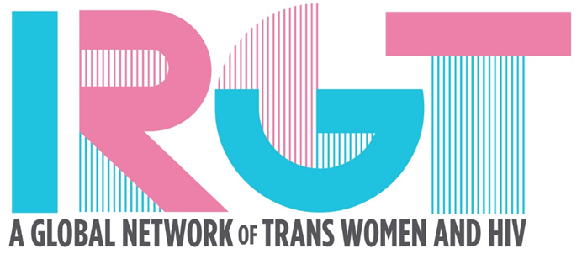



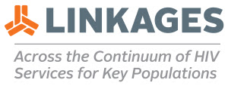
With Thanks
Acknowledgment: Nikita Wiswasam for slides and graphic design

Slide 5
HIV Pandemic in 2018
36.9 Million
21.7 Million
17.5 Million
1.8 Million
^{Source: UNAIDS, 2018}

Slide 6
Case Studies
  Adolescent Girls and Young Women in Tanzania
  People Who Inject Drugs in Eastern Europe
  Gay Men and other Men who have Sex with Men & Transgender Women in Senegal
  Indigenous Communities in Latin America
  Female sex workers in South Africa

Slide 7
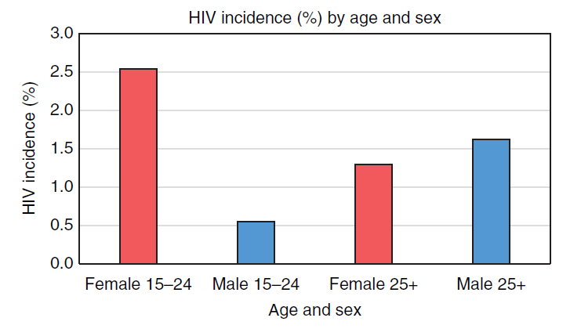
HIV among Adolescent Girls and Young Women
No Evidence of Regional Differences in Why People Have Consensual Sex
  For Procreation
  For Pleasure
  For Need
Evidence of Regional Differences
  Needs Differ
  Access to Appropriate Education and Commodities
  HIV Prevalence within Sexual Networks
^{Source: UNAIDS, 2018;} Dellar. Dlamini, Karim, 2015; Shisana, 2014

Slide 8
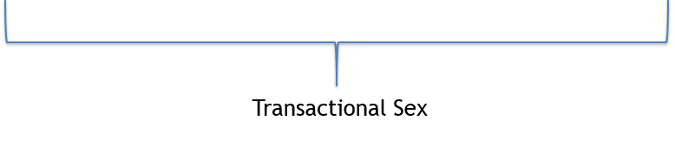
HIV-Related Risks among AGYW
  Significant Determinants of HIV Infection among AGYW in Southern and Eastern Africa
INDIVIDUAL
NETWORK-LEVEL
STRUCTURAL
Alcohol and Drug Use
Condom Use
STIs
Age-Disparate Partnerships
Knowing Partner’s HIV Status
Multiple Partners
Physical and Sexual Violence
Condom Negotiation
Sources: Ssewenya et al 2018, Dellar et al 2015, Killburn et al 2018; Jewkes et al 2010, 2012, Ranganathan et al 2016, Rositch et al 2012, Choudhry et al 2015, Pascoe et al 2015

Slide 9
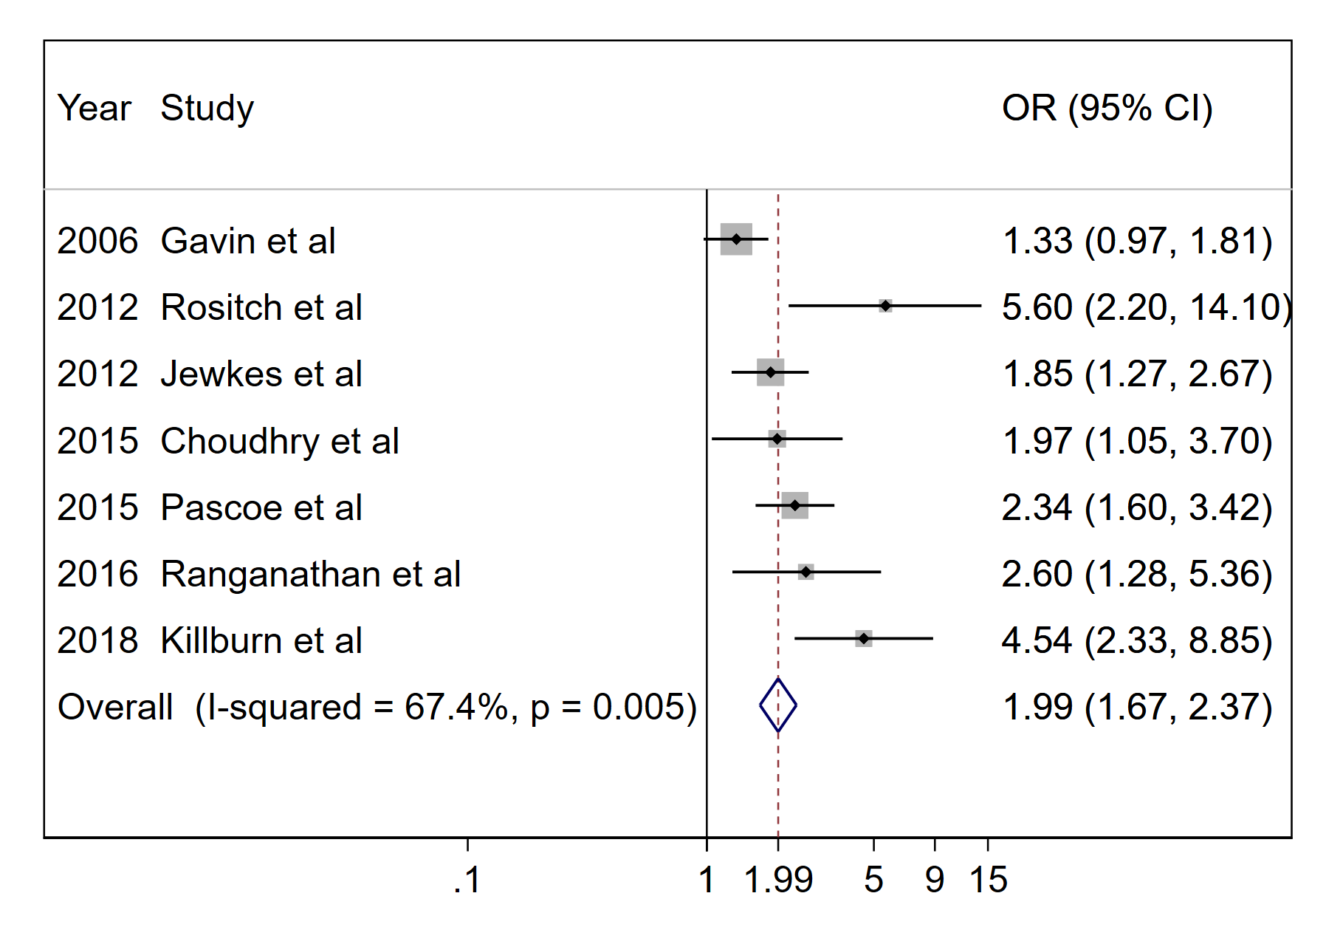
HIV and Transactional Sex Among AGYW
²Killburn et al 2018; ³Jewkes et al 2012, ⁴Ranganathan et al 2016, ⁵Rositch et al 2012, ⁶Choudhry et al 2015,⁷Pascoe et al 2015
Notes:
Adolescent girls and young women (13-24) in sub-Saharan Africa reporting transactional sex have a ~2-3 higher odds of living with HIV^{2,3,4,5,6,7}
AGYW in TS who frequently get money from their partners or report casual partners have the highest risk

Slide 10
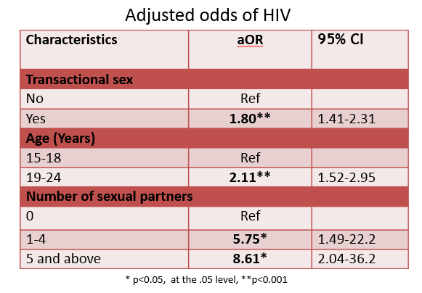
Transactional Sex among AGYW in Tanzania
Population | Positive (Last Test Negative within 12 months) | Total Tested | Annual New HIV Infections (%)
 | n(%) | n (%)
AGYW Reporting TS | 18 | 1,171 | 1.5
AGYW with no TS | 32 | 4,186 | 0.8
All AGYW | 50 | 5,357 | 0.9
Sources: Mbita, Casalini, Curran, Komba, 2018

Slide 11
Case Studies
  Adolescent Girls and Young Women in Tanzania
  People Who Inject Drugs in the Russian Federation
  Gay Men and other Men who have Sex with Men & Transgender Women in Senegal
  Indigenous Communities in Latin America
  Female sex workers in South Africa

Slide 12
New HIV Cases in Eastern Europe and Former Soviet Union
Source: Санкт-Петербург, 5 октября 2017г.

Slide 13
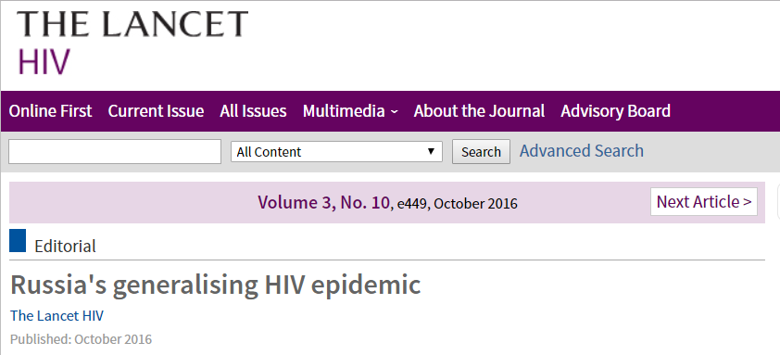
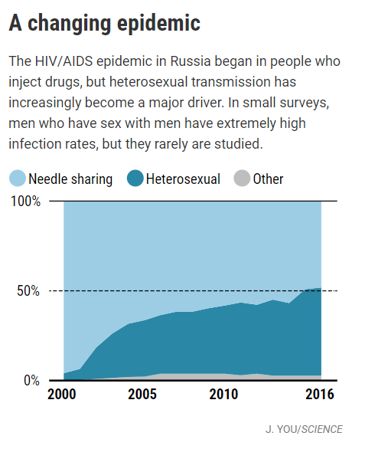
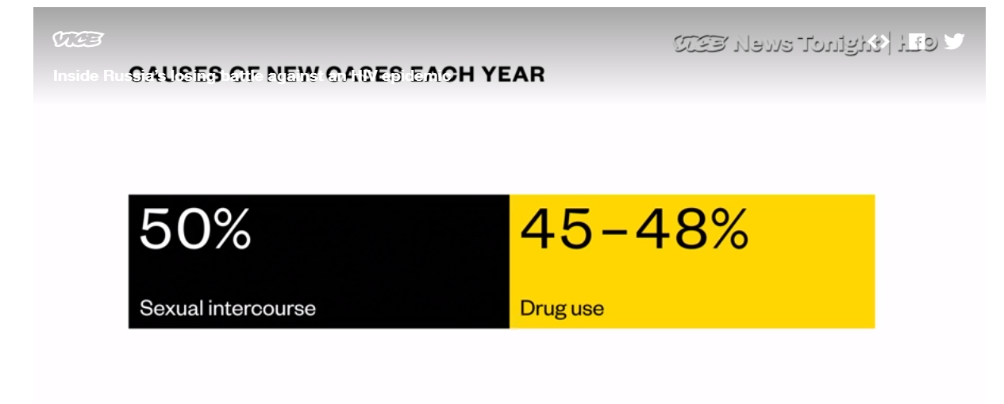
Concentrated or Generalized Epidemic in Russia?

Slide 14
HIV Among Key Populations in Russia, 2017
Prevalence (%)
St. Petersburg
City
Source: Санкт-Петербург, 5 октября 2017.
Notes:
Volgograd: MSM 13.3% (16.7% HCV), PWID 34,2 (98.2), FSW 8,2 (36.1) This suggests that MSM and FSW are also injecting, with such high HCV.
Lost the Excel file for this when computer shut down on its own.

Slide 15
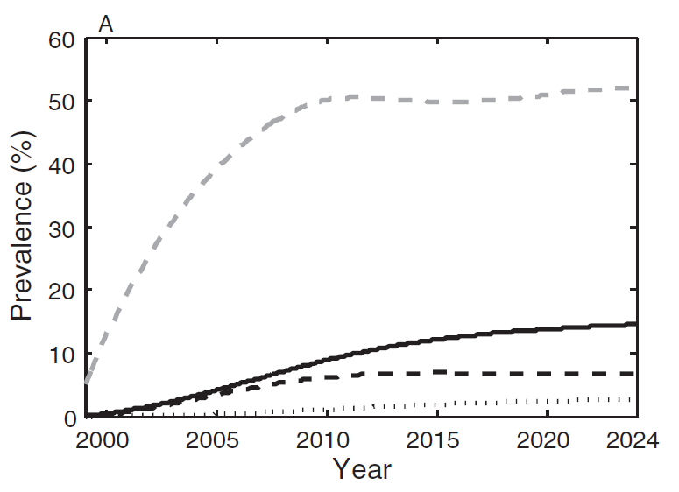
HIV Transmission from PWID to Sexual Partners in St. Petersburg, Russia
PWID Infected Parenterally
Sexual Partners of PWID
PWID Infected Sexually
Partners of Partners of PWID
Source: Mills, White, Colijn, Heimer 2013

Slide 16
Estimated Distribution of HIV Infections across Populations in the Russian Federation
Calculated from: Mills et al, Санкт-Петербург, 5 октября 2017.

Slide 17
Case Studies
  Adolescent Girls and Young Women in Tanzania
  People Who Inject Drugs in Eastern Europe
  Gay Men and other Men who have Sex with Men & Transgender Women in Senegal
  Indigenous Communities in Latin America
  Female sex workers in South Africa

Slide 18
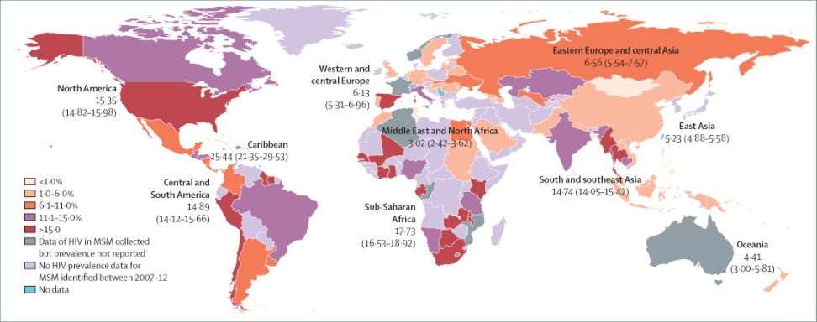
HIV Prevalence among MSM 2007-2016
No Evidence of Regional Differences in the Diversity of Sexual Orientations and Gender Identity
Evidence of Regional Differences
  Nomenclature and Outward Sexual and Gender Expression
  Social Acceptance
  Punitive and Protective Laws
Updated from: Beyrer, Baral, van Griensven, Goodreau, Chariyalertsak, Wirtz, Brookmeyer, The Lancet, 2012

Slide 19
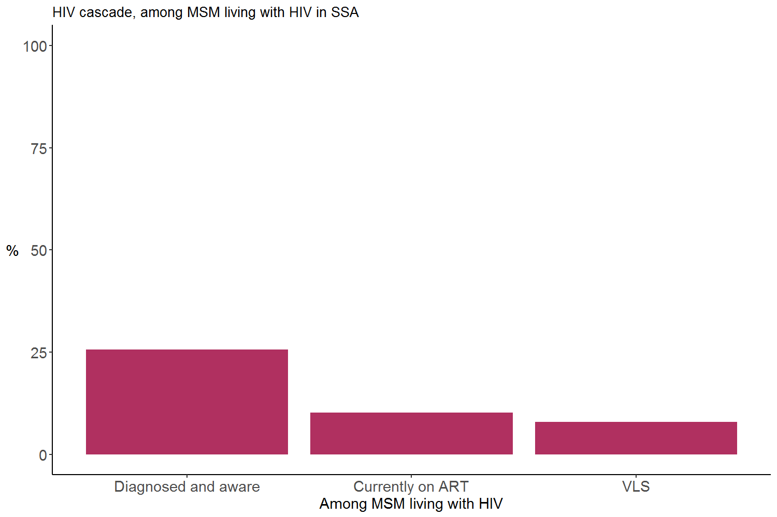
HIV Treatment Cascade among MSM Across Sub-Saharan Africa
25.6%
10.2%
7.9%
N=16
40.0%
(95% CI:26.8,54.7)
N=6
30.8%
(95% CI:11.3,60.7)
N=44
25.6%
(95% CI: 20.5,31.5)

Slide 20
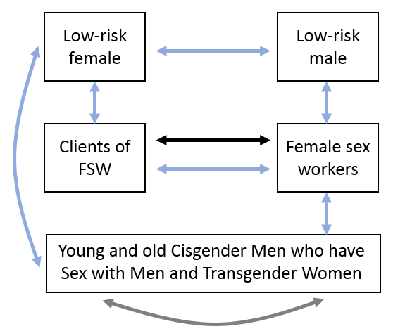
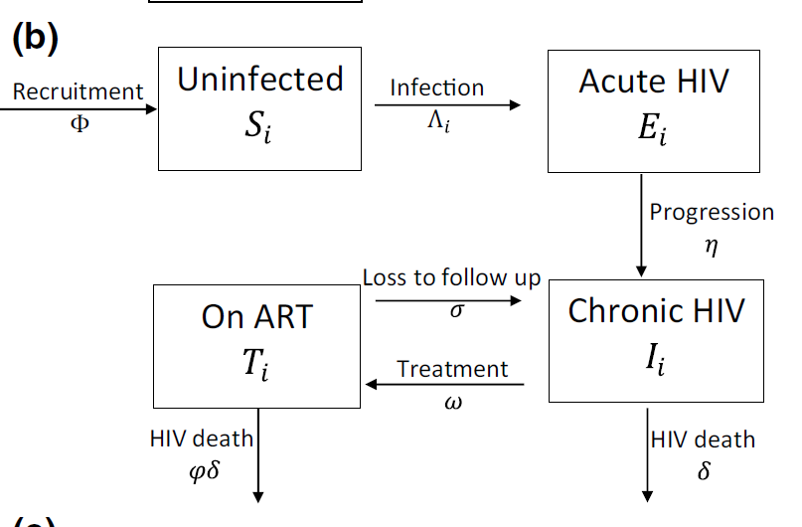
Assessing Attributable Fraction among MSM and Trans Women in Senegal
Source: Vickerman, Diouf, Toure Kane, Mukandavire, Volz, Boily, et al 2018

Slide 21
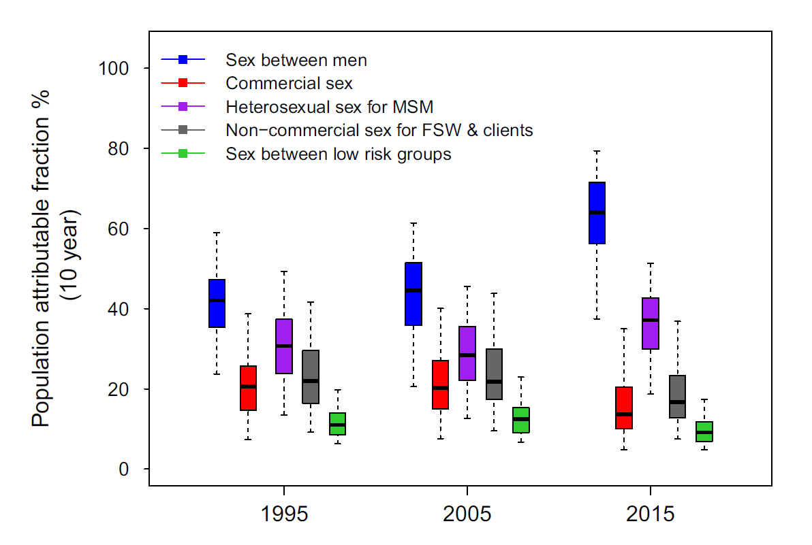
HIV Population Attributable Fraction In Senegal
Source: Vickerman, Diouf, Toure Kane, Mukandavire, Volz, Boily, et al 2018

Slide 22
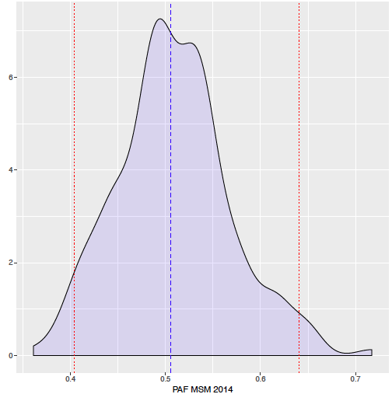
Phylodynamic Assessment of Attributable Fraction of MSM in Senegal
Analyzing HIV sequences from PLHIV and MSM in Senegal
  Phylogenetically clustered cases among MSM with Subtype C and AG
Dated Phylogenies used to fit HIV Epidemic trajectory
Preliminary MSM PAF estimates consistent with Epidemiologic Model
  Median PAF of 51% (40-64%)
MSM PAF
Source: Volz, Nascimento, Vickerman, Boily, 2018

Slide 23
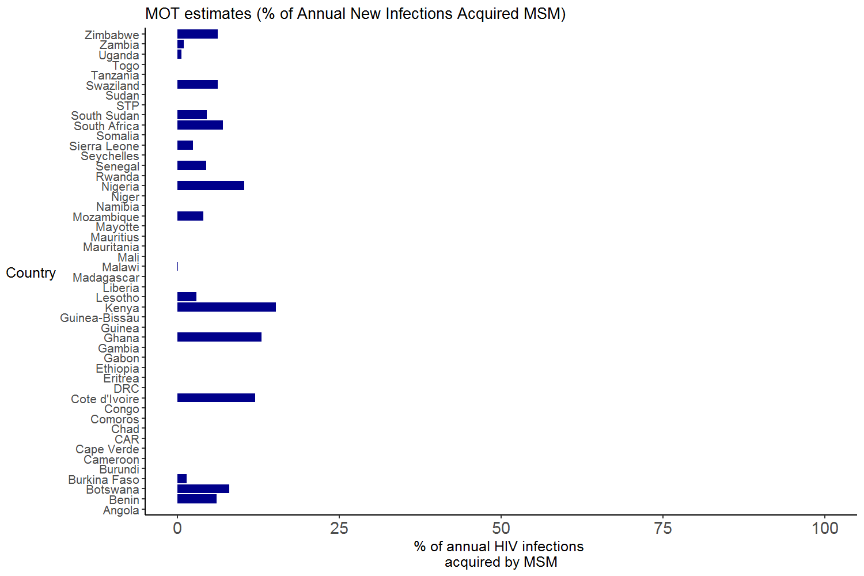
Estimates of Attributable Fraction to Same-Sex Practices across Sub-Saharan Africa
Kenya PAF Estimate:
15.9%
Modified from Shubber, Mishra, Vesga, Boily, 2014
Notes:
Updated in 2018 from Shubber et al. 2014
X-axis from 0-100%

Slide 24
Case Studies
  Adolescent Girls and Young Women in Tanzania
  People Who Inject Drugs in Eastern Europe
  Gay Men and other Men who have Sex with Men & Transgender Women in Senegal
  Indigenous Communities in Latin America
  Female sex workers in South Africa

Slide 25

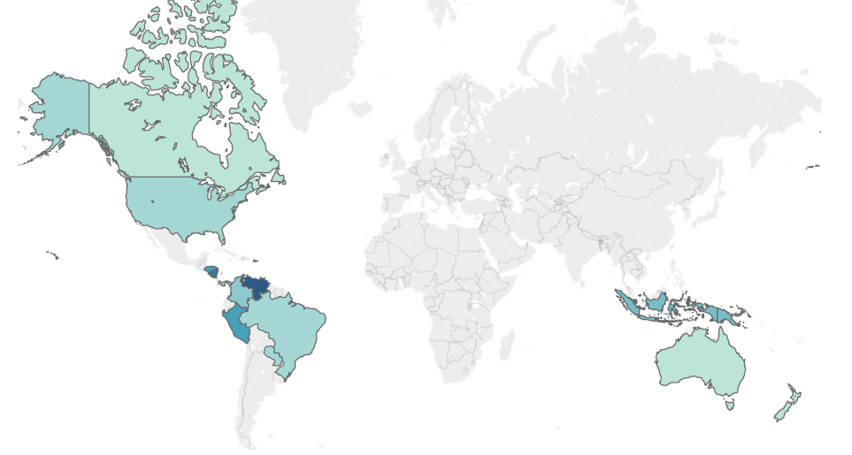
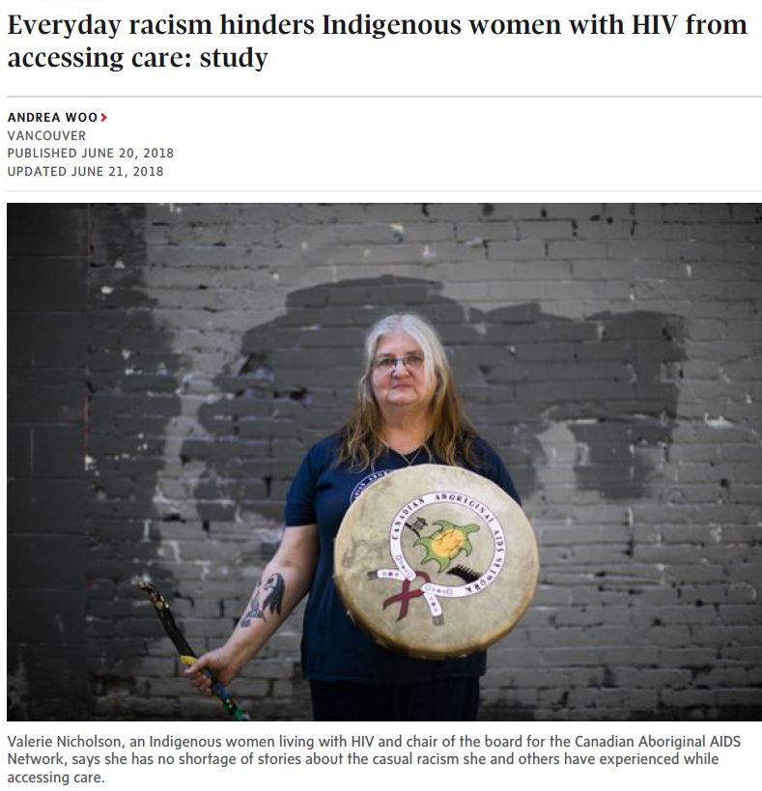
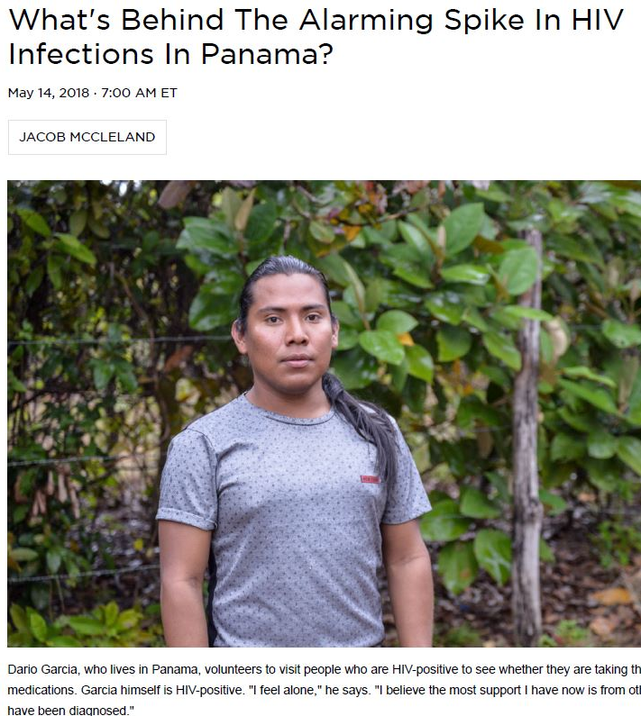
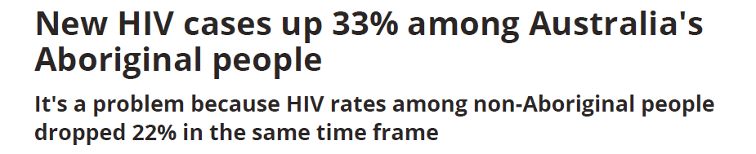
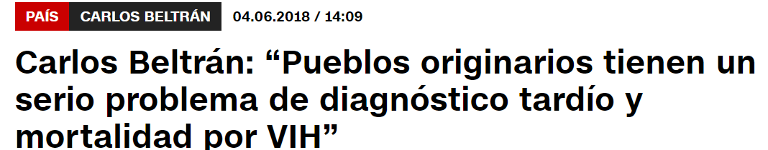
HIV Prevalence among Indigenous Communities
%
<0.1
.1-1
1-2
2-3
3-4
4-5
5-6
6-7
7-8
8-9
9-10
Sources: Benzaken et al 2017, 2012, Paz-Bailey et al 2009, Zavaleta et al 2007, Bartlett et al 2017, Villalba et al 2007, Ponce et al 2017, Mendoza et al 2013, Garcia, Bayer, Carcamo 2014. Munro et al 2015,
Vallely et al 2010, Graham et al 2017, CDC 2018, Jacob McCleland/NPR; Kirk Semple, Meridith Kohut/NYT; Andrea Woo, Rafal Gerszak/Globe & Mail; Shannon Power/Gay Star News; Alex Soluducha/CBC;CNN Chile

Slide 26
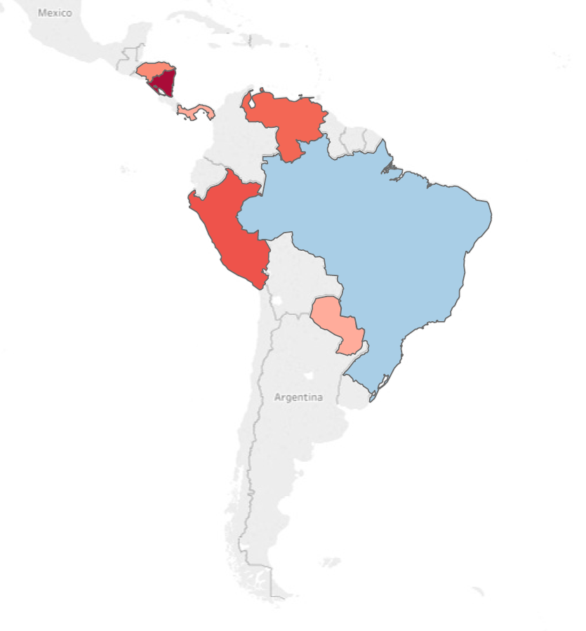
HIV prevalence ratio: Indigenous people vs national average
Rate ratio HIV-related mortality: Indigenous people vs national average
1.0 33
9
HONDURAS
Garífuna
4.76
COLOMBIA
16.3-33
NICARAGUA
Garífuna, Miskito
2
PANAMA
Kuna
3.13
CHILE
Aymara
16
VENEZUELA
Warao
1.7-18.7
PERU
Chayahuita
0.26-1.4
BRAZIL
Yanomami & others
2
PARAGUAY
Maká, Sanapaná & others
Sources: Benzaken et al 2017, 2012, Paz-Bailey et al 2009, Zavaleta et al 2007, Bartlett et al 2017, Villalba et al 2007, Ponce et al 2017, Mendoza et al 2013, Garcia, Bayer & Carcamo 2014

Slide 27
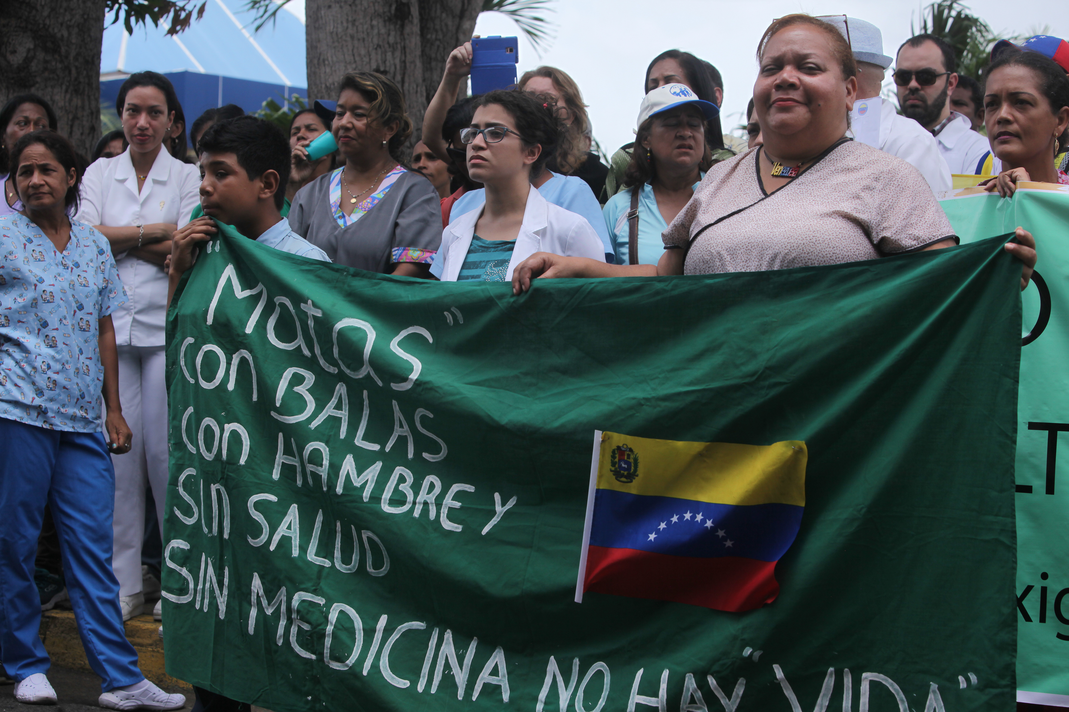
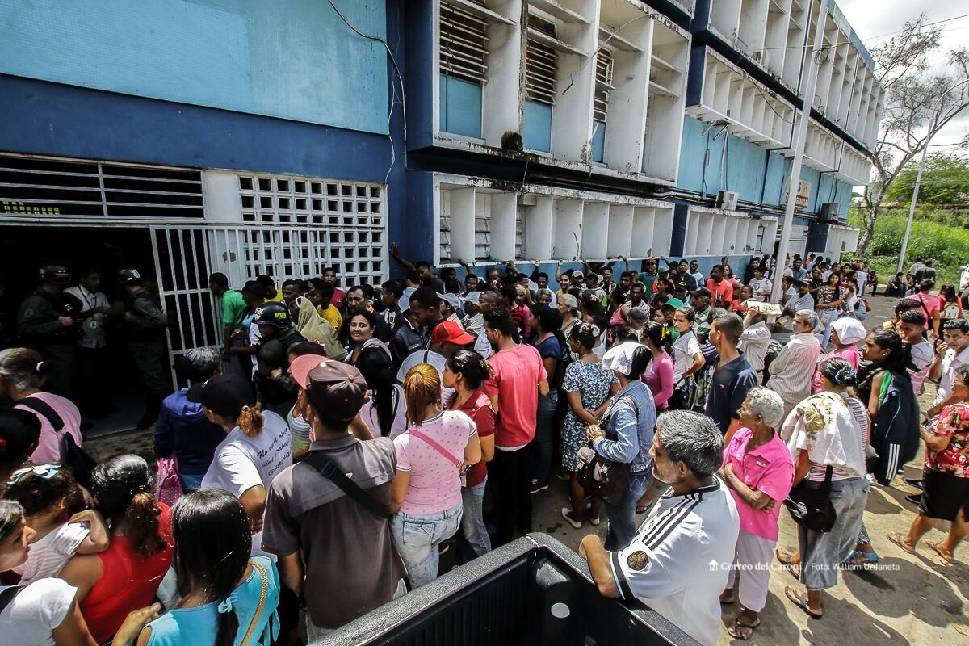
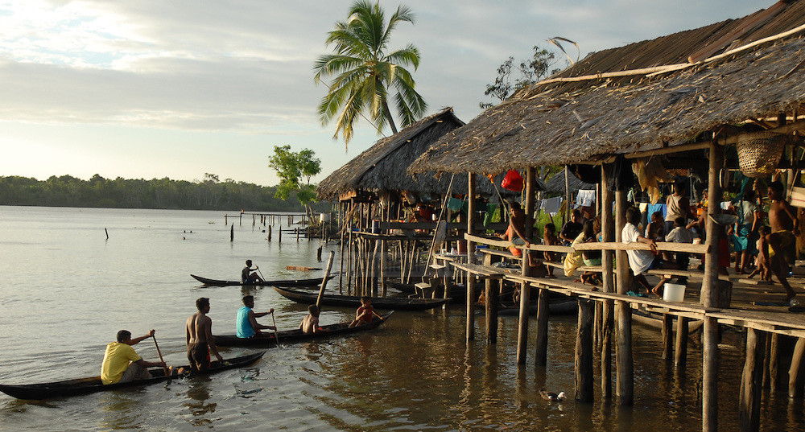
Venezuela
Since 2011
  5x higher malaria incidence
  75% increase in AIDS-related deaths
Indigenous Populations
  Wayuu & Warao
  Warao
    HIV Prevalence Estimate: 9.6% (n=576)
      Other health indicators
        High Mobility
        Limited HIV Knowledge
        Limited Education Access
Source: International Council of AIDS Service Organizations (ICASO) & Acción Ciudadana Contra el sida (ACCSI ), Villalba et al 2013, Photo William Rafael, Urdaneta Heredia, Ramon LePage
Notes:
HIV prevalence of 9.55% in 8 Warao communities, significantly higher among men (15.6%) than women(2.6%)
Highest in the Usidu community with 35% among men and 10% among women

Slide 28
HIV Vulnerabilities among Indigenous Communities
Proximal HIV-Related Risks
  Similar sexual and parenteral-related risks to other people living with HIV
Differential HIV Burden Driven by Structural Risks
  Systematic Exclusion from National HIV Prevention Services and Global Guidance Documents
  Limited Cultural Relevance of Existing Services
  Intersectional Stigmas
    Indigenous Specific
    Racism
    Within community stigma affecting Two-Spirit people, those who use drugs, sell sex, and/or are living with HIV
Sources: Orellana et al 2013, Ponce et al 2017, Benzaken et al 2017, Villalba et al 2013, Goldenberg et al 2012
Notes:
- ART treatment, CD4, viral load testing most available in cities and higher level hospitals. Lack of availability of HIV - treatment and HIV services in indigenous locations (Ponce et al 2017)
- Poverty, lack of employment and educational opportunities
- Lack of health campaigns targeted at indigenous groups, limited HIV/STI knowledge
- High cost of travel to urban areas to access HIV services
- Absence of culturally competent care & indigenous language translators
- Migration and mobility, (Ponce). Mobility a key HIV risk (Goldenberg et al 2012; Benzaken 2017, Ponce et a 2017; Orellana 2013)
-Lack of economic, social, sexual and reproductive health rights among women (Ponce 2017, Orellana et al 2013)

Slide 29
Case Studies
  Adolescent Girls and Young Women in Tanzania
  People Who Inject Drugs in Eastern Europe
  Gay Men and other Men who have Sex with Men & Transgender Women in Senegal
  Indigenous Communities in Latin America
  Female sex workers in South Africa

Slide 30
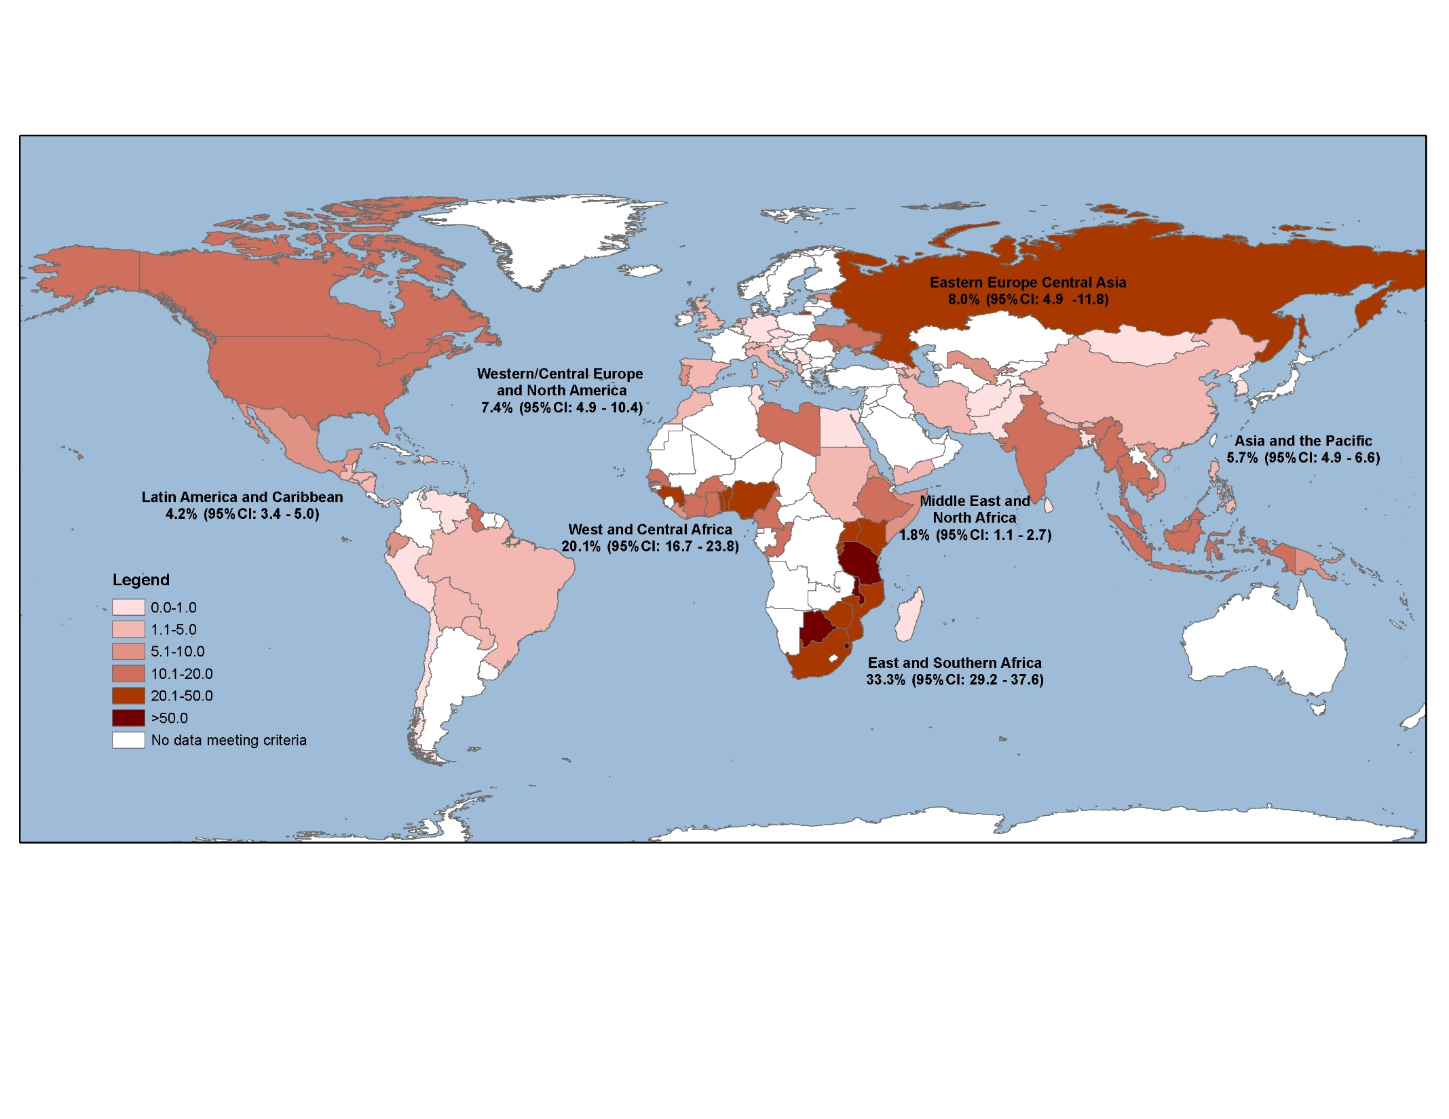
Global Burden of HIV Among Female Sex Workers, 2006-2017
Source: Shannon, Crago, Baral, et al. 2018

Slide 31
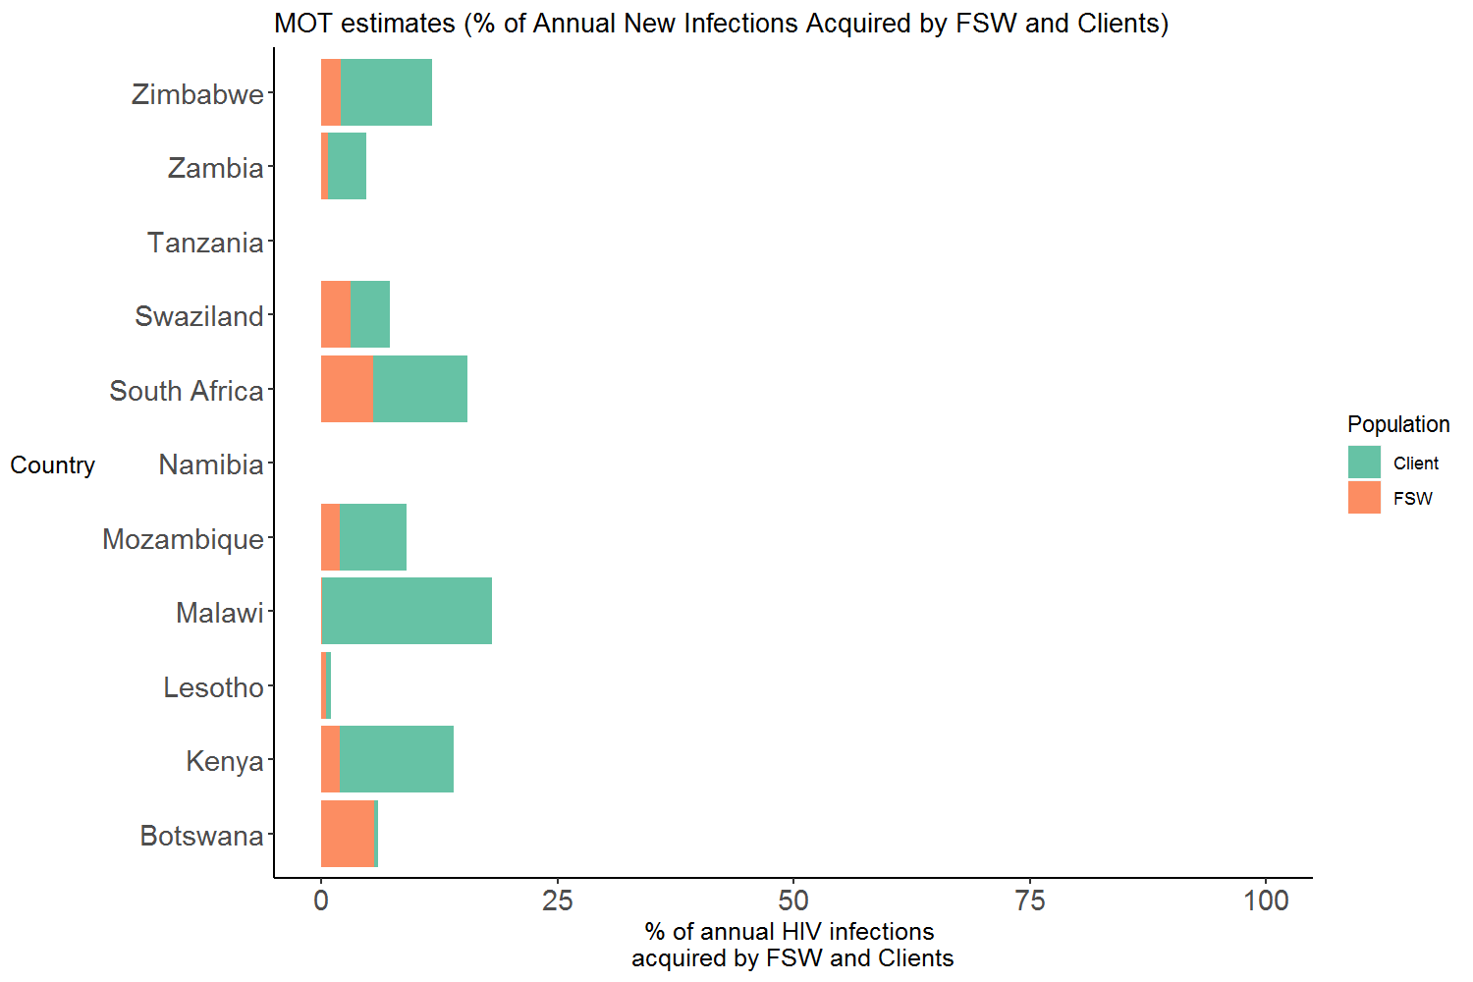
Estimates of Attributable Fraction to Sex Work in South and East Africa
Modified from Shubber, Mishra, Vesga, Boily, 2014

Slide 32
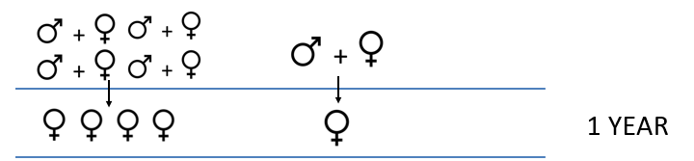
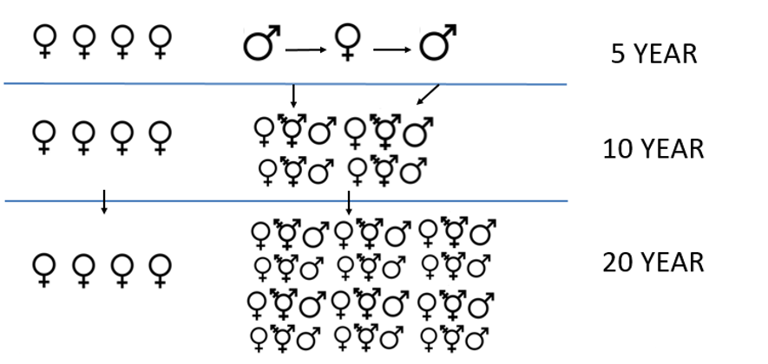
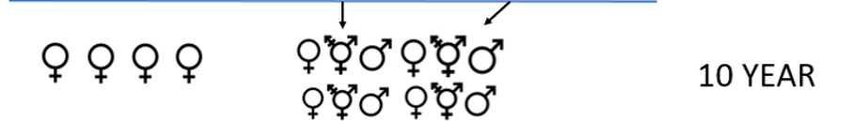
Serodiscordant Partnerships
FSW and Male Partners
(Clients and Non-Paying Partners)

Slide 33
Demographic & Epidemiological Heterogeneity Within Sex Work
Female
Male
FSW–high volume
Client–high volume
FSW - Female Sex Worker
MP - Multiple partnerships with transactional sex
Two age-groups
14-24; >24
FSW–low volume
Client–low volume
MP– high volume
MP– high volume
MP – low volume
MP – low volume
Always low-risk
Always low-risk
Former FSW
Former Client
Former MP
Former MP
Source: Mishra et al 2017

Slide 34
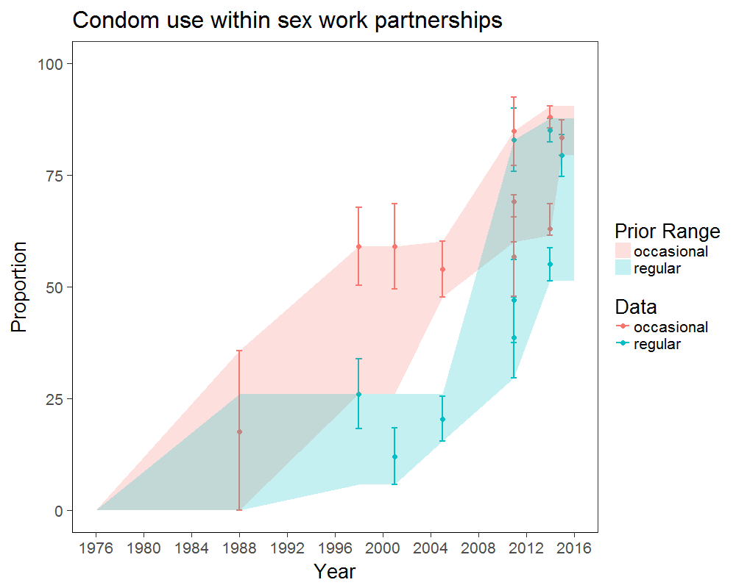
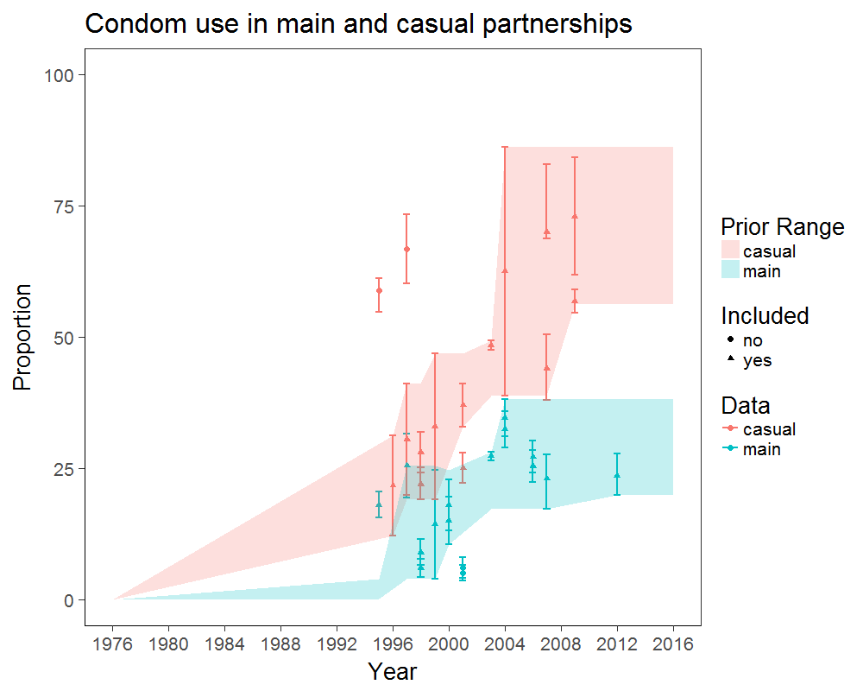
Condom Use and ART as Time-Dependent Parameters
Source: Mishra et al 2017
Notes:
“Shaded area represents the sampling range based on the best available data from representative/population-based surveys, and removal of estimates with selection bias (e.g. clinics). Stratified by occasional and regular clients. The data points reflect the point estimate and 95% CI. The dashed line represents an interpolated sample parameter set for condom-use over time (by type of partnership) drawn as a prior for model fitting.”

Slide 35
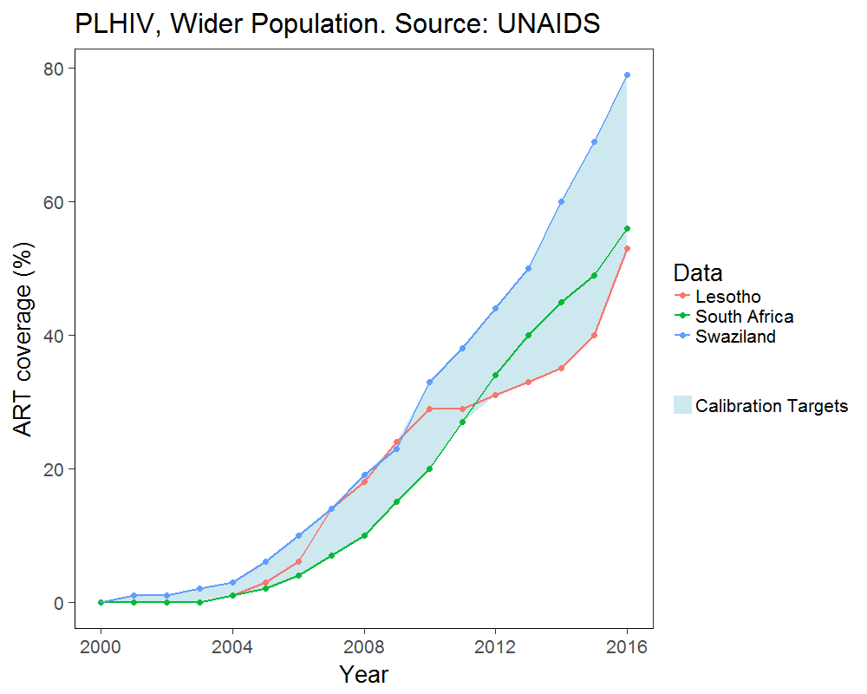
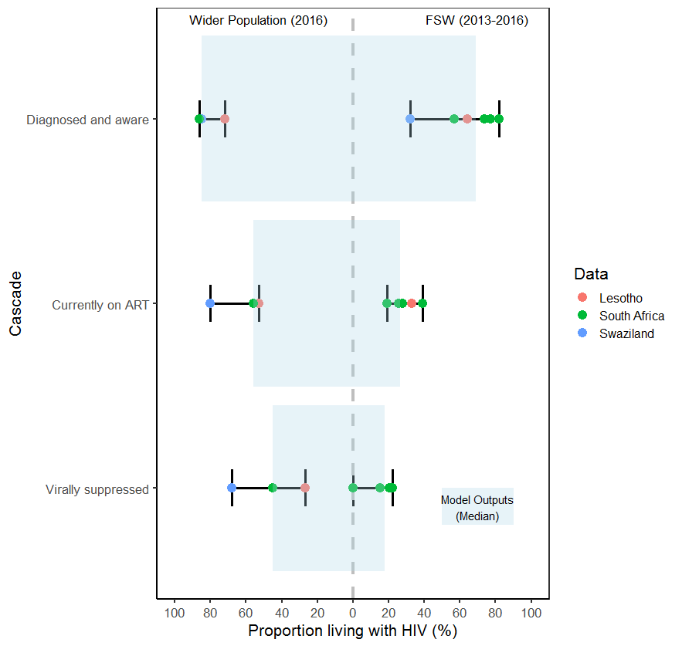
Calibration Targets: HIV Cascade by Population
Wider population (2016)
FSW (2013-2016)
Diagnosed
& aware
Currently
on ART
Virally suppressed
Source: Mishra et al 2017
Notes:
The FSW cascade was matched to the year for which data were available (2013-2016).
For prior/other years, we interpolated the ‘prevalence ratio’ in the cascade estimates between FSW and wider-population females.
Blue bar graphs represent the median from 190 model fits.
Due to lack of data on clients re: HIV cascade, assumed to be similar to wider population males.

Slide 36
% Cumulative New Infections Attributable to Unsuppressed Viral load Among FSW Living with HIV
N=190 model fits to Southern Africa epidemic and baseline cascade, wider population estimates exclude FSW and clients
¹Mishra et al 2017
Source: Mishra et al 2017

Slide 37
Case Study Messages
Adolescent Girls and Young Women
  Characterizing actual proximal and structural risks for HIV will inform intervention planning
People Who Inject Drugs in Eastern Europe
  Most infections emerge from unmet treatment needs among PWID, other key populations, and their sexual partners
Gay other Men who have Sex with Men & Transgender Women Across Sub-Saharan Africa
  Preconceived notions of the epidemiology of HIV based on geography and social contexts challenges an evidence-based and effective response
Indigenous Communities in Latin America
  Systematic barriers to coverage of HIV services results in sustained or expanding epidemics among Indigenous Communities in much of the world
Female sex workers in Southern Africa
  40 years into the HIV pandemic suggests the need to use models that take a longer view of transmission dynamics to inform HIV prevention and treatment scale up

Slide 38
Moving Forward
HIV is not Zika
  The risks for HIV are not evenly distributed in any population anywhere in the world
Move away from the term “general population”
  Understanding who and why people are at risk for and living with HIV can support improved individual services and larger scale program implementation

